Slide 1





Module
01
INTRODUCTION TO ESG
(SME PERSPECTIVE)
Funded by the European Union. However, the views and opinions expressed are solely those of the author(s) and do not necessarily reflect the views of the European Union or Turkish National Agency. Neither the European Union nor the grant-awarding body can be held responsible for these views and opinions.

Slide 2

Agenda Module 1
01
Understanding ESG: distinction from sustainability and compliance
02
Identifying ESG drivers: market, regulation, stakeholders, finance
03
Assessing risks and opportunities through an ESG lens
04
Overview of key regulatory frameworks (CSRD, ESRS, CSDDD
05
Seeing ESG as a competitive factor – not just a reporting duty
06
ESG benchmarking: where does your company stand today?

Slide 3

Delimitation of Sustainability, ESG & Compliance
Sustainability
⁰¹
Sustainability:
Individual behavior, corporate strategies and social responsibility
Environmental, social and economic responsibility for future generations
Relevance also for the actions of state actors
ESG
⁰²
ESG:
For companies and investors
Comes from the financial context
Orientation for investors and stakeholders for assessing the sustainability performance and risks of companies
Compliance
⁰³
Compliance:
Concerns legal rules and regulations for companies
Overlaps between ESG and compliance due to increased regulation

Slide 4
Mood Picture on the Subject Of ESG/Sustainability
What experience
do you have
With ESG?
What role does sustainability
play in your company?

Slide 5
What Are Drivers of ESG?
Sustainable Development
Legal Drivers (ESG)
Markets as Drivers
Club of Rome 1986
2015 Paris Declaration
2016 SDGs
EU-Taxonomie
Lieferkettengesetz, CSDDD
CSRD/ESRS
EBA Guidelines
EU-Taxonomie
Lieferkettengesetz, CSDDD
CSRD/ESRS
EBA Guidelines

Slide 6
ESG APPROACH
ESG Approach
OFFENSIVE
Sustainability
Management
vs.
DEFENSIVE
Regulation
What are the Risks of not having a Sustainability Strategy?

Slide 7
What Questions do Companies ask Themselves?
The sustainability benchmark: Where does my company currently stand with regard to the requirements of the Corporate Sustainability Reporting Directive (CSRD) and other regulatory and market-driven requirements?
Navigating ESG regulation: What does the complexity of ESG regulation mean for my company? Where is my company directly and indirectly affected?
What are the opportunities and risks for my company and my business models? What are the requirements of customers and markets?
What does ESG mean for financing and investor valuations?
Key people for ESG: How can I effectively identify and involve key people for ESG tasks in my company?
Raising awareness of ESG: How can I sensitize my team to ESG issues and raise awareness?

Slide 8
Framework Map
Framework | Level | Initiator | Commitment | Focus
ESRS/CSRD | EU | EU | legally | holistic
EU-Taxonomy | EU | EU | legally | CO₂, Climate goals
Supply Chain Act | D | BMAS | legally | Supply Chain / Human Rights
CSDDD | EU | EU | legally | Supply Chain / Human Rights
VSME | EU | EU | legally | middle: specifically for KMU
DNK | D | Initiative | voluntary | holistic
OECD-Guidelines for Multinational Enterprises | global | OECD | voluntary | holistic
UNGC (UN Global Compact) | global | UN | voluntary | holistic
SDGs (Sustainable Development Goals) | global | UN | fvoluntary | holistic
ISO 14001 | global | ISO | voluntary | Environmentmanagement
ISO 26000 | global | ISO | voluntary | Social responsibility
GRI (Global Reporting Initiative) | global | GRI | voluntary | holistic
SASB (Sustainability Accounting Standards Board) | global | SASB | voluntary | Industry-/themespecific
TCFD (Task Force on Climate-Related Financial Disclosures) | global | FSB | voluntary | CO₂, Climaterisks
SBTi (Science Based Targets initiative) | global | SBTi | voluntary | CO₂
EU Regulation on deforestation-free supply chains | EU | EU | legally | Supply Chain / Environment
EU Waste Packaging Regulation | EU | EU | legally | Trash, packaging
EBA-Guidelines | EU | EBA | indirect | Risk/Governance

Slide 9
Corporate Sustainability Reporting Directive
Subdivision of CSRD - Original Timeline
01
02
03
04
Companys which
are affected by
NFRD already:
Big E
U-Companys:
Capital Market
Oriented KMU:
Capital Market
Oriented KMU:
Capital market oriented
More than 500 MA
250 MA
More than 50 Million revenue
More than 25 Million Total Assets
More than 10 MA
More than 0,7 Million revenue
More than 0,35 Million Total Assets
If the KMU option is chosen for extension
Report for 2025
Report for 2026
Report for 2027
Report for 2029
Fiscal Year 2024
Fiscal Year 2025
Fiscal Year 2026
Fiscal Year 2027-2028

Slide 10
Corporate Sustainability Reporting Directive - One Level with financial reporting
Before CSRD
After CSRD
Situation Report
Financial Reporting:
CSRD
Financial Report
Sustainability Report:
Equal to
Goal: More Transperancy and Comparability of Companys with regard to Sustainability
Implementation in national Right until July 2024

Slide 11
Changes CSRD – Adaptions by Omnibus
CSRD until Omnibus
CSRD after Omnibus
Aspect
Companies with more than 250 Employees report required.
Reportrequirement starting in 2024 for big Companies
Detailed Report with lots of Datapoints after ESRS.
EU-Sustainability standards (ESRS) seperated from other EU- Guidelines
Whole Value Chain approach
Companies with more than 1000 Employees report required.
Shifting the Report requirements to 2 years from now
Reducing the Datapoints, Simplification of Requirements.
Improvement in Coherence between CSRD and other EU-Regulations
*Value Chain Cap: only VSME infos from SMEs!
Threshold for
Reporting Requirement
Deadlines
Reporting Obligations
and Data Points
Coherence with
other EU-Guidelines
*Banks and clients could need specific infos, therefore materialiy analysis stongly recommended

Slide 12
Corporate Sustainability Reporting Directive - CSRD
⁰¹
Double Check Materiality Analysis
⁰²
Define Sustainability Goals
MAIN CONTENT -
What should be considered?
Sustainability belongs in the final report
(Management report)
⁰³
Ensure Testability Through External Examiner
⁰⁴
Ensure Machine Readability (ESAP, XBRL)
⁰⁵
Report On Business Models, Strategies, & Expected Developments
⁰⁶
Creating Comparibility & Transparency

Slide 13

CSRD..
Which Customers are
affected by CSRD?
How close are they to the assessment limits?

Slide 14
European Sustainability Reporting Standards (ESRS)
- An Overview of the Standards
Cross-Cutting-Standards
ESRS1 General principles
ESRS 2 General, strategy, governance and materiality assessment disclosure requirements
Enivronment
ESRS E1 Climate Change
ESRS E2 Pollution
ESRS E3 Water and marine resources
ESRS E4 Biodiversity and ecosystems
ESRS E5 Resource use and circular economy
Social
ESRS S1 Own workforce
ESRS S2 Workers in the value chain
ESRS S3 Affected communities
ESRS S4 Consumers and end-users
Governance
ESRS G1 Business Conduct

Slide 15

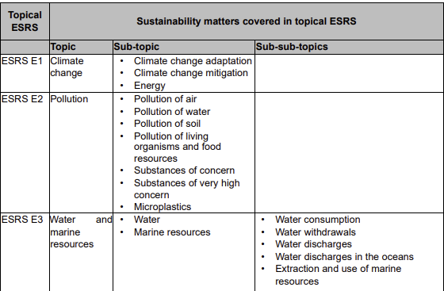
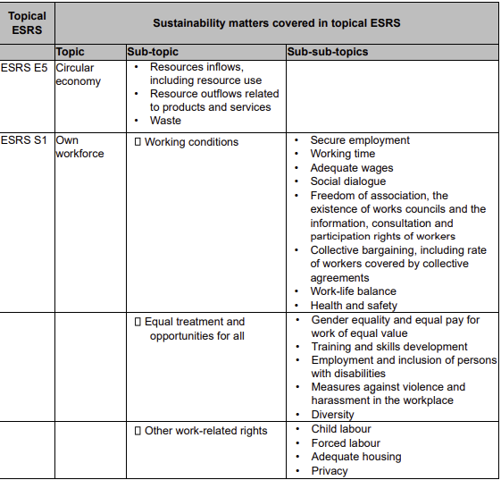
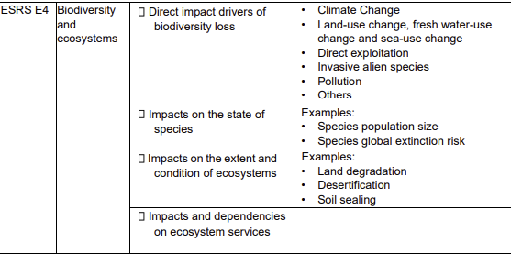
European Sustainability Reporting Standard (ESRS) – Cutouts to the Companies

Slide 16
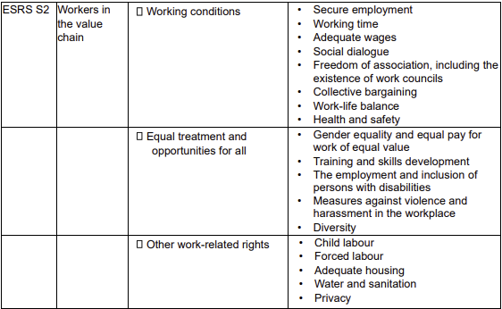
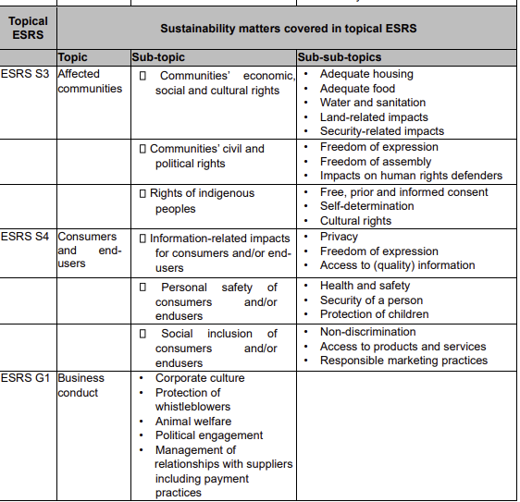

European Sustainability Reporting Standard (ESRS) – Cutouts to the Companies

Slide 17
Corporate Sustainability Due Diligence Directive (Csddd) – Core Obligations
⁰¹
Introduction to a due Dilligence Process
⁰²
Strategy Adjustment to Ensure Consistency with the Goals of the Paris Agreement
⁰³
Development of a Risk Management Plan
⁰⁴
Damage Minimization: Taking Measures To Reduce Damage or risks if there are any Identified
⁰⁵
Responsible Business Relationships
⁰⁶
Transparency and Reporting: Regular and Transparent Reporting on due Diligence Measures and their Effectiveness
⁰⁷
Establishment of a Complaints Procedure
⁰⁸
Penalties for Non-compliance: Fines Based On Company Turnover: 5% Of Net Turnover as the Minimum-maximum Penalty Range.

Slide 18
Corporate Sustainability Due Diligence Directive
(CSDDD) before Omnibus
01
02
03
04
FINANCIAL MARKET PLAYERS
Company
Group 1:
Company
Group 2:
Company
Group 3:
Implemation in national right
More than 5.000 MA
Revenue of more than 1,5 Billion Euros
More than 3.000 MA
Revenue of more than 900 Million Euros
More than 1.000 MA
Revenue of more than 450 Million Euros
Fiscal Year 2026
Fiscal Year 2027
Fiscal Year 2028
Fiscal Year 2029
https://eur-lex.europa.eu/legal-content/EN/TXT/?uri=CELEX%3A52022PC0071

Slide 19
Changes CSDDD; LKG Already Under Scrutiny
Regulation | Before Omnibus (CSDDD Originally) | After Omnibus-Initiative
Scope of Application (Employees) | Companies with > 1.000 employees | > 3.000 employees
Revenue limit | > 450 Million Euros | > 900 Million Euros
Implementation deadline | From 2027 | Deadline postponed by up to 2 years
Responsibility in Suppky Chains | Strict Due-Diligence-Duties for the whole Supply Chain | Duties reduced, Focus on „key areas of business“
Liability and Sanctions | Companies are liable for violations | Less strict liability regulations
Supply Chain | Whole Supply Chain | Direct Suppliers, starting at a specific size

Slide 20
Corporate Sustainability Due Diligence Directive (CSDDD)
– Ein Möglicher Due Dilligence Prozess
01
03
05
07
Risk
Identification
Development of
Mitigation Plans
Monitoring & Reporting
Review & Continuous
/ Improvement
02
04
06
Risk Assessment
Implementation of Risk Measures
If Damage Occurs: Remedy

Slide 21
Corporate Sustainability Due Diligence Directive (CSDDD)
Liability:
Scope of the regulation: Activities of Business partners along the entire supply chain
  Production of goods, services, product development, raw material extraction, procurement, processing, Transport, delivery and storage.
  Indirect Suppliers in the upstream supply chain are included.
  Sanctions:
  Regularity control: Combination of fines and civil liability.
    Fines: Maximum 5% of net annual turnover.
  Civil liability:
    Cross-border incidents: application of the law of EU Member States.
    Improving access to civil law protection and simplifying procedures.

Slide 22



Supply Chain ​​Monitoring
– Risk-based Approach
High probability of Occurence
Medium Risk
High Risk
Very High Risk
Medium probability of Occurence
Low Risk
Medium Risk
High Risk
Low probability of Occurance
Very Low Risk
Low Risk
Medium Risk
Low Impact
Medium Impact
High Impact

Slide 23
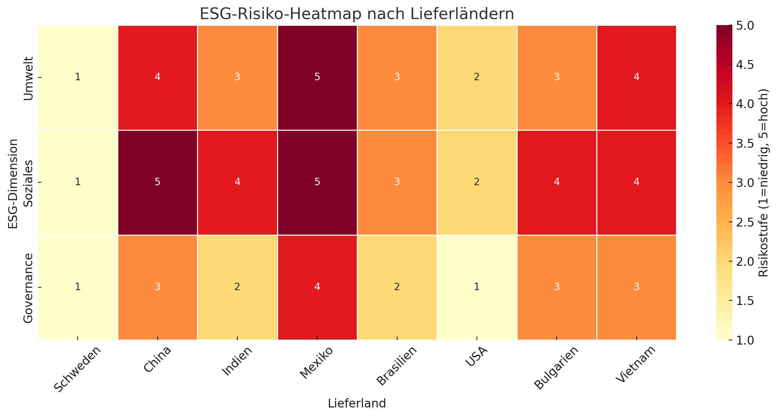
Example Heatmap

Slide 24
CSDDD..
Which customers are affected by CSDDD?
Which customers of customers are affected by CSDDD?

Slide 25
EU-TAXONOMY Main Content
01
02
03
04
FINANCIAL MARKET PLAYERS
DISCLOSURE OF SUSTAINABLE FINANCIAL FLOWS
CONTENT
PARALELS TO CSRD
6 ENVIRONMENTAL GOALS
What is a sustainable Investment?
Which Financial
flows fill the Taxonomy?
  Weakening Climate Change
  Adjustment to Climate Change
  Sustainable Usage and Protection of Water- and Oceanressources
  Transition to a circular ecinomy
  Protection and Schutz und Recovery of Biodiversity and Ecosystems
  Prevention of environmental pollution
Takeaway: Real Economy: What are my taxonomy-mandated activities? What is compliant and what isn‘t?

Slide 26
EU-TAXONOMY – Technical Evaluation criteria, what‘s that?
Significant contribution to at least one environmental objective
Fulfilment of certain minimum requirements
Do no significant harm“ With Regard to other Environmental Goals
Criteria for taxonomy conformity

Slide 27
EU-TAXONOMY – What is a significant contribution?
Climate Protection: An activity contributes significantly to climate protection if it significantly reduces or avoids greenhouse gas emissions or stores carbon. Examples include renewable energies, energy efficiency, and carbon capture technologies.
Adaptation to climate change: A significant contribution to climate change adaptation is to reduce the risks and adverse effects of climate change on people, nature, or the economy. This could be achieved, for example, by creating climate-resilient infrastructure or ecosystems.
Sustainable use and protection of water and marine resources: Activities that contribute significantly to this goal improve water use efficiency, protect aquatic ecosystems, or prevent water pollution.

Slide 28
EU-TAXONOMY – What is a significant contribution?
Transition to a circular economy: Activities that reduce resource use, promote recycling, extend product durability, or reduce waste, such as circular production models, could make a significant contribution.
Prevention and reduction of pollution: Activities that significantly reduce the release of pollutants into the air, water, or soil, or that minimize the use of hazardous chemicals, contribute significantly to this goal.
Protection and restoration of biodiversity and ecosystems: Activities that prevent the loss of biodiversity or restore ecosystems, such as reforestation or the protection of natural areas, can be considered a significant contribution.

Slide 29
EU-TAXONOMY – Revenue KPIs for non-financial companies
^{5%}
Revenue-KPI (EU-Taxonomy)
Taxonomy-aligned
Non-taxonomy-aligned
^{95%}
⁰¹
The revenue KPI measures the proportion of net revenue associated with taxonomy-compliant economic activities.
⁰²
Revenue KPI = Net revenue from taxonomy-compliant activities / Total net revenue x 100
For example: 50.000/1.000.000 x 100 = 5%

Slide 30
EU-TAXONOMIE – Disclosure of CapEx KPIs in accordance with EU taxonomy
⁰¹
The CapEx KPI shows what proportion of a company's capital expenditure (CapEx) flows into taxonomy -compliant economic activities. This includes investments in assets or processes that are sustainable and support the environmental objectives of the EU taxonomy.
⁰²
How does the CapEx plan work?CapEx plan: A CapEx plan shows how the company will use its investments to make its activities taxonomy-compliant in the future. The plan must clearly state that these activities will become sustainable within five years (or a maximum of ten years for complex projects).
⁰³
Formula for CapEx KPI: CapEx KPI = Taxonomy-compliant capital expenditures / Total capital expenditures * 100
For example: 400.000 / 10.000.000 * 100 = 4%

Slide 31
EU-TAXONOMIE – Disclosure of OpEx KPIs in accordance with the EU Taxonomy
⁰¹
The OpEx KPI measures the proportion of a company's operating expenses (OpEx) that goes toward taxonomy-compliant activities. This KPI provides information about which operating expenses are used directly or indirectly to support sustainable economic activities.
⁰²
What are the total operating expenses (in the denominator):
Research and development (R&D)
Maintenance and repairs of property, plant, and equipment (e.g., machinery, buildings)
Building renovation measuresShort-term leases
⁰³
What are taxonomy-compliant operating expenses (in the numerator):
Related to taxonomy-compliant economic activities, such as training for workers or direct costs for implementing measures to reduce greenhouse gas emissions.
Part of a CapEx plan that aims to make existing activities taxonomy-compliant or supports investments in sustainable technologies.
Related to climate change adaptation or other environmentally friendly measures (e.g., building renovations to improve energy efficiency).
⁰⁴
Formula for OpEx KPI: OpEx KPI = Taxonomy-compliant operating expenses / Total operating expenses * 100
For example : 400.000 / 10.000.000 * 100 = 4%

Slide 32
VSME
B1 B Fundamentals of reporting
B2 Sustainability practices, policies, and initiatives
B3 Energy consumption and greenhouse gas emissions
B4 Environmental pollution
B5 Biodiversity
B6 Water consumption and water stress
B7 Resource use, circular economy, and waste management
B8 Workforce – general information
B9 Health and safety
B10 Compensation, collective bargaining agreements, training
B11 Corruption and bribery
C1 Business model & sustainability-related strategies
C2 Sustainability practices for transitioning to a greener economy
C3 Climate targets and transition plans
C4 Climate-related risks
C5 Extended disclosures on the workforce
C6 Human rights policy
C7 Serious human rights violations
C8 Revenue from critical sectors and exclusion criteriaC9 Gender
diversity in corporate governance

Slide 33
What is the EBA – and why does it affect your company?
EBA: European banking supervisory authority
⁰¹
Responsible for the regulation and supervision of banks in the EU area
Issues binding guidelines, including on lending
What is new on 30. June 2025?
⁰²
Guidelines EBA/GL/2020/06 (revised 2024) come into force
Banks must systematically assess ESG risks – for every loan they grant
Banks are not acting voluntarily → but are driven by regulation
Warum betrifft das Ihr Unternehmen?
⁰³
Banks require ESG information during credit assessments.
Those who cannot demonstrate an ESG strategy, data, or structures risk higher interest rates, conditions, or loan rejection

Slide 34
Four Pillars of ESG Integration According to EBA Guidelines
Riskevaluation
(Rn. 93-98)
ESG-Factors = creditworthiness factors
Credit Granting Processes
(Rn. 157-162)
Scoring, Pricing,
contract drafting
01
02
03
04
Governance Structures
(Rn. 45-52) ESG in
Anchor corporate strategy
Monitoring
(Rn. 214-218)
Continuous ESG-monitoring

Slide 35
What your Bank wants to know about you In June 2025 – Concrete
Risk Analysis
⁰¹
Which ESG risks could affect your financial situation or ability to repay? (Example: transition risks, physical risks, social and governance factors)
Governance Structures
⁰²
Clear responsibilities, ESG anchoring in management, compliance systems, and control processes
Traceable ESG - Daten
⁰³
No formal Duties to EU-Key figures – but banks expect resilient, structured ESG-Informations

Slide 36
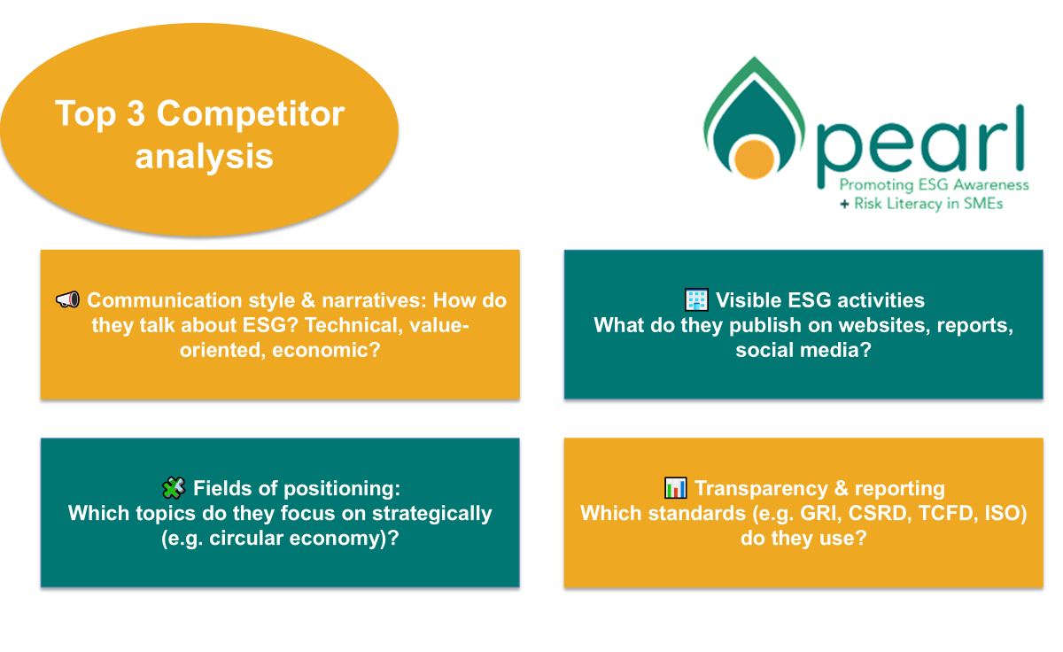
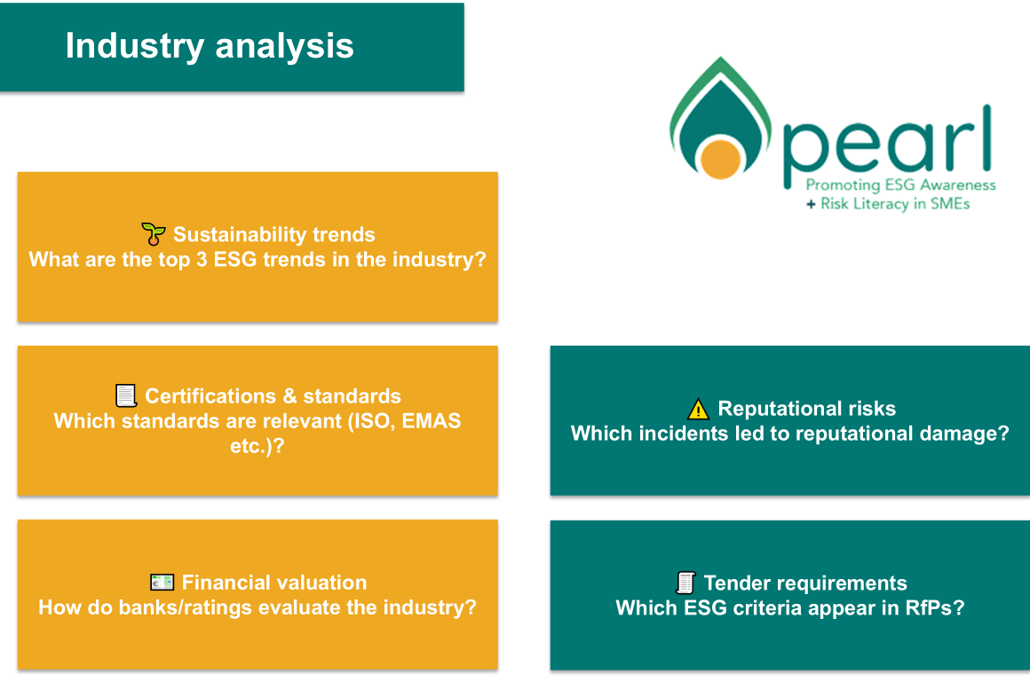
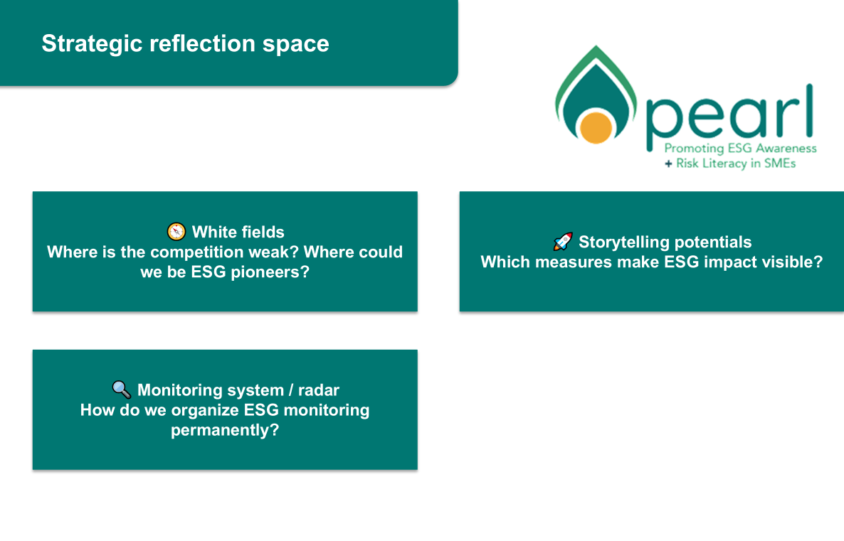
Industry & Competitor Check (Toolbox)

Slide 37
Summary: ESG Activities for SME
⁰¹
Create an overview of risks
⁰²
Create an overview of your own industry and ESG trends
⁰³
Analyze customers and value chains according to requirements
⁰⁴
Record the requirements of financial players and request your own ranking
⁰⁵
Record key data on ESG

Slide 38

Follow our journey
li
in
yt
www.esgforenterprise.eu

