Slide 1





Module
02
ESG ONBOARDING, VISION
& RESPONSIBILITY
Funded by the European Union. However, the views and opinions expressed are solely those of the author(s) and do not necessarily reflect the views of the European Union or Turkish National Agency. Neither the European Union nor the grant-awarding body can be held responsible for these views and opinions.

Slide 2

Agenda Module 2
01
ESG kick-off workshop as strategic starting point
02
Setting up the ESG team and defining key roles
03
Involving internal stakeholders and departments
04
Onboarding decision-makers with interactive formats
05
Building ESG awareness and shared strategic direction
06
Structuring responsibilities and steering mechanisms

Slide 3
ESG Onboarding
– Kick-Off & Design of Project
01
Conduct Kickoff Workshop
02
Define ESG Core Team
03
Set Key Project Milestones
04
Perform Industry & Competitor Benchmarking
05
ESG Onboarding for Decision Makers & Leadership Team

Slide 4

ESG Start Workshop
What is the purpose of the ESG kick-off workshop?
The ESG kick-off workshop is the central tool for revealing the status quo of ESG activities within the company—and for systematically clarifying responsibilities, data sources, and next steps.
It is particularly effective when designed as an interactive format involving relevant departments, roles, and stakeholders.
A typical workshop lasts one day – compact, practical, and forward-looking.

Slide 5
ESG Start Workshop
Key content of the ESG kick-off workshop
Make existing ESG structures visible - What data, initiatives, and responsibilities already exist? Who is responsible? What works?
Appoint an ESG core team
A small steering team (usually 2–3 people) coordinates the analysis and liaises with specialist departments and management.
Identifying relevant Stakeholders - Who provides information? Who is affected by ESG or actively involved in shaping it?
Assess the information situation - Reports, guidelines, KPIs, processes – compile, structure, and evaluate internal sources
Identify key ESG issues - Based on ESRS & materiality analysis: Which topics are actually relevant for our company?

Slide 6
ESG Start Workshop
Typical Roles in ESG Onboarding
Human Recources: Diversity, Inclusion, Workculture
Procurement: Supply Chain Data, Risks in Precursors
Production: Sustainable Manufacturing Processes, Ressource Use
Compliance / IT / Data Protection: Specific Governance-Topics
C-Level: Strategic Prioritization, Ressource Allocation, Setting Direction
Success factor: A clear Start, shared understanding
A well prepared ESG Kick-off workshop provides Orientation, builds internal Acceptance – and is often the decisive moment for transforming ESG from a marginal issue to a Top-Level Priority.

Slide 7
Who can I talk to? Construction of an ESG-Team
Steering
Committee
Main Contact Person + Coreteam (from E, S and G), PMO
Contactperson for Specific ESG Topics

Slide 8
ESG Team and Relevant Internal Contributors to ESG Topics (Toolbox)
Role / Position | Knowledgeable about / responsible for topics within the following areas
 | E (Environmental Topics) | S (Social Topics) | G (Governance Topics) | Suppliers & Value Chain | Certifications / Audits | Marketing / ESG Communication | Customer / Client ESG Topics | ESG-related Financial KPIs | ESG Reporting | Remarks / Notes

Slide 9
ESG Project Milestones
Milestone No. | Milestone Title | Description | Expected Timeline (Month)
1 | Project Kick-off & Team Setup | Define key project steps, form ESG team, and align communication plan. | Month 1
2 | Gap Analysis Workshop | Evaluate ESG gaps, identify key topics and determine priorities. | Month 2
3 | Stakeholder Mapping & Engagement | Identify internal and external stakeholders and engage them. | Month 2
4 | Double Materiality Assessment | Perform double materiality analysis (inside-out & outside-in). | Month 3
5 | Definition of ESG Strategy & Objectives | Set long- and mid-term ESG goals, define focus areas and governance. | Month 4
6 | Implementation of ESG Programs & KPIs | Launch ESG initiatives with clear KPIs and accountability. | Month 5–6
7 | Monitoring and Adjustment (PDCA Cycle) | Monitor implementation with sustainability management software. | Month 7–8
8 | First ESG Report delivered | Deliver first report. | Month 9
9 | Branding Check completed | Validate ESG integration into branding. | Month 9

Slide 10
ESG Onboarding Workshop for C-Levels
The Goal of this measure
An interactive workshop helps top management understand ESG not just as a regulatory requirement, but as a strategic area of ​​action.
An initial stimulus and a structured SWOT analysis create a shared understanding of opportunities, risks, and required resources. Onboarding ensures that ESG is embedded and actively supported at the C-level—a prerequisite for implementation and visibility.

Slide 11
ESG Onboarding Workshop for C-Levels
Typical Construction of a ESG-Onboarding
Impulse (30 Min.)
Current ESG requirements (CSRD, Supply Chain Act, CSDDD) and their direct relevance to the company – clear, fact-based, strategically prepared.
Interactive Workshop (60 Min.)
SWOT analysis in the ESG context: Identify opportunities and risks for the market, customers, supply chains, product development, and access to capital.
Putting strategic Questions in the Center
How does ESG affect our business Strategy?
Which stakeholders expect Visibility?
How can we make ESG a driver of innovation?

Slide 12
ESG Onboarding Workshop for C-Levels
Impulse & Tools
Toolset Onboarding Decision Makers - Overview of the company and ESG issues
Scenario-Technology - Developing concrete visions of the future – e.g., regarding new customer requirements, ESG-based competition, or regulatory pressure.
Nightmare Competitor - Competitive analysis with a focus on ESG: How would a “more sustainable competitor” threaten our position?
Brand Visibility Check - How visible is ESG within the company? What signals are being sent to customers, applicants, and the public?

Slide 13
ESG Onboarding Workshop for C-Levels
Target vision at the end of the workshop
C-level management is familiar with the relevant ESG drivers
Initial ESG SWOT analysis for the company's own business model is available
Clarity regarding internal responsibilities and strategic to-dos
Positive attitude toward ESG initiatives established

Slide 14
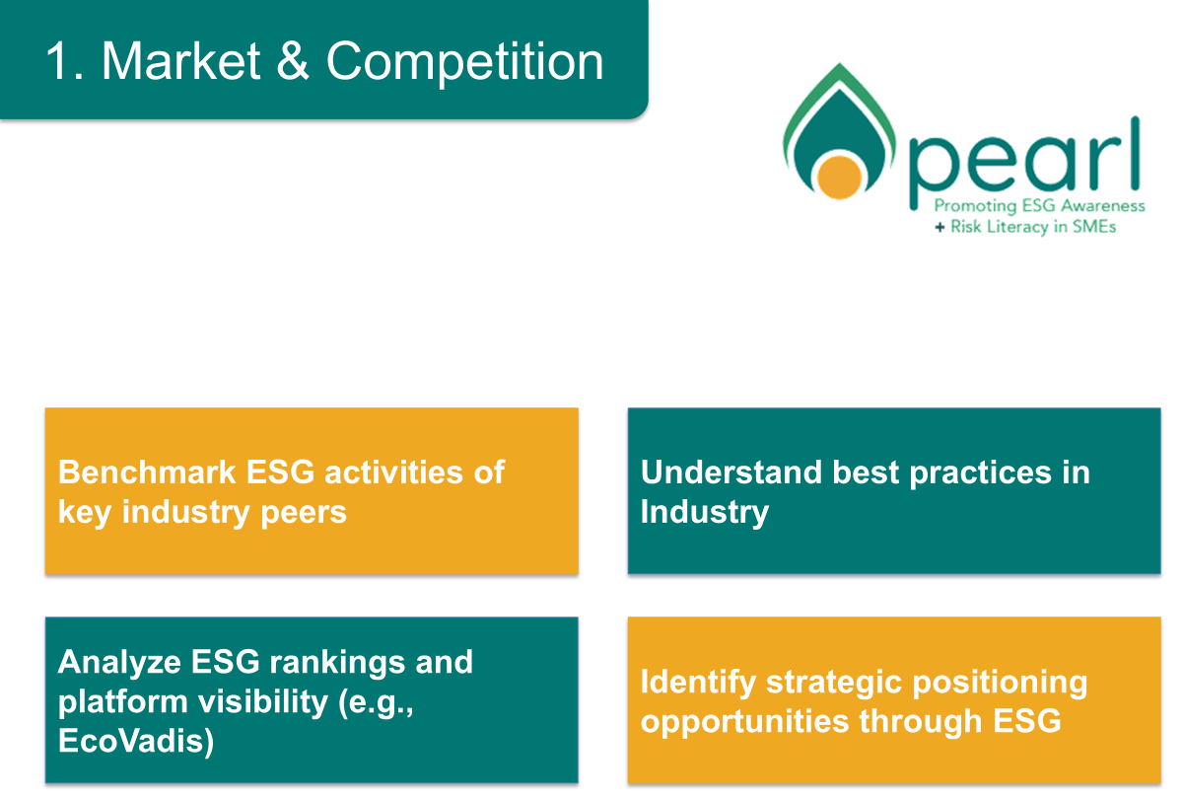
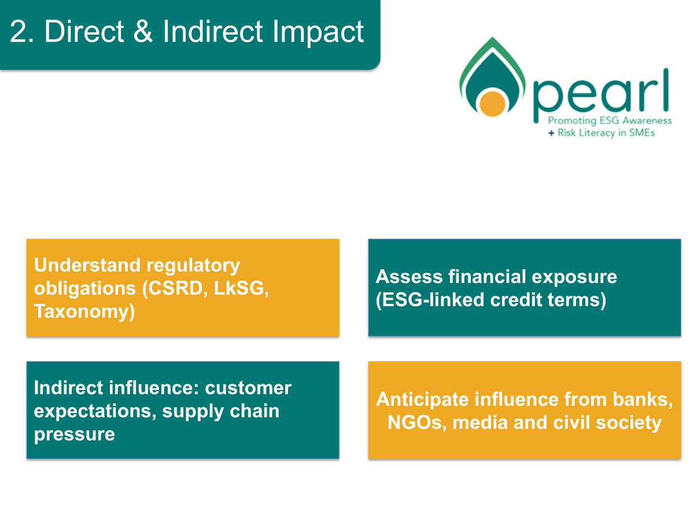
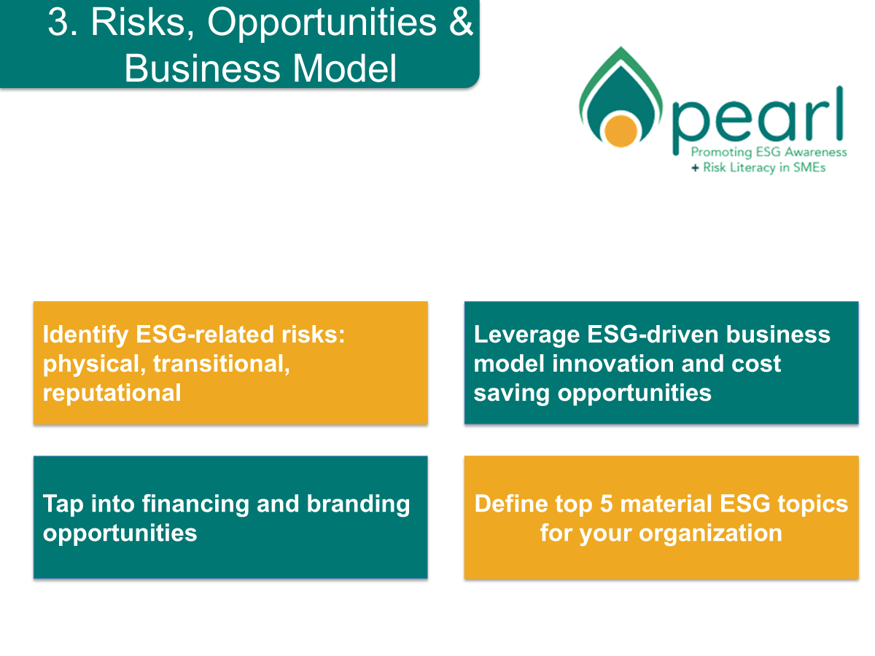

Onboarding internal Decision Makers
1. Market & Competition
2. Direct & Indirect Impact
3. Risks, Opportunities
& Business Model
4. Team, Resources
& Results

Slide 15
List of Internal Stakeholders Template Stakeholder Analysis
Stakeholders | Interest in the project | Influence on the project | Contact person for ESG topic
Insert name of stakeholder group or name
For example., Manager, sales team, shareholder | High | High | Compliance - Person AA
For example., Works Council | Medium | Medium | Risk management - person XX
Insert name of stakeholder group or name | High | High | Circular economy
Insert name of stakeholder group or name | Low | Low | Human Capital – Person YY
Insert name of stakeholder group or name
Insert name of stakeholder group or name

Slide 16
Internal Stakeholder Analysis - Transfer
High
Continuous Information
Working Together
Insert name of stakeholder group or stakeholder
Insert name of stakeholder group or stakeholder
Insert name of stakeholder group or stakeholder
Stakeholder Interest
Observe
Maintaining Trust
Stakeholder Interest
contact name
contact name
contact name
Low
Low
Influence Of Stakeholders
High

Slide 17

ESG Onboarding for Holistic Change..
ESG onboarding does not end with workshops or individual measures—it requires a holistic view of changes within the company.
The 4Q model helps to systematically address individual, cultural, competency-related, and structural aspects.

Slide 18
The four Perspectives of an
effective ESG-Onboarding
INSIDE – INDIVIDUAL (Mindset)
INSIDE – COLLECTIVE (Culture)
OUTSIDE – INDIVIDUAL (Competence)
OUTSIDE – COLLECTIVE (Processes, KPIs, Organisation)
Focus: Values, motives, fears, beliefs. Key question: “Why is this important to me?”
Goal: Raise awareness, build acceptance, and create personal commitment
Measures: Communication, participatory workshops, emotional anchors
Focus: Shared standards, vision, organizational climate. Key question: “How well does ESG fit with our culture?”
Goal: Anchoring ESG in our vision, language, and collective self-image
Measures: Mission statement workshops, culture checks, joint values work
Focus: Skills, behavior, willingness to learn
Key question: “What new things do I need to learn and be able to do?”
Goal: Developing ESG-relevant skills and mindsets
Measures: Training, coaching, ESG-specific training modules
Focus: Structures, systems, key figures
Key question: “What needs to be adjusted within the company?”
Goal: Effectively integrate ESG into processes and management
Measures: ESG KPIs, software solutions, adjustment of reporting and management systems
Takeaway: The 4Q model provides a proven basis for tackling all levels of change in a structured manner
and embedding ESG sustainably within the organization.

Slide 19

Follow our journey
li
in
yt
www.esgforenterprise.eu

